Slide 1
Comparative Analysis of the Homeless Veteran and Non-Veteran Demographic Profiles and Disabilities at Urban Ministries of Durham
Presented by Meagan Foster
Fall 2019

Slide 2
Objectives
Homeless veterans in the US
Compare race, gender, and age for non-veteran and veteran clients at UMD
Compare prevalence of disabilities for non-veteran and veteran clients
Summary

Slide 3
Homeless veterans in the US
Approximately 11% of the homeless population are veterans
Most Veterans who experience homelessness are men over age 50 living in urban areas.
Among Veterans experiencing sheltered homelessness in 2016, about 9 in 10 (91%) were men, about the same as for all U.S. Veterans.
Veteran women are more than twice as likely as non-Veteran women to experience homelessness.
Nearly 6 out of 10 (59.1%) Veterans experiencing sheltered homelessness in 2016 were age 51 or older

Slide 4
Homeless veterans in the US
Veterans experiencing sheltered homelessness were 3.3 times more likely to identify as African American or Black, compared to all U.S. Veterans (38.2% vs. 11.4%) in 2016
A majority (55%) of Veterans experiencing sheltered homelessness had a disability
Among Veterans experiencing homelessness who received health care services from the VA:
More than one in four (28%) received diagnoses of chronic medical conditions
More than one in four (28%) received a diagnosis of depression
One in eight (13%) received a diagnosis of PTSD
About one in five (19%) received a diagnosis of alcohol abuse
About one in five (20%) received a diagnosis of drug abuse.

Slide 5
How does the demographic characteristics of a homeless veteran compare to that of a non-veteran at UMD?

Slide 6
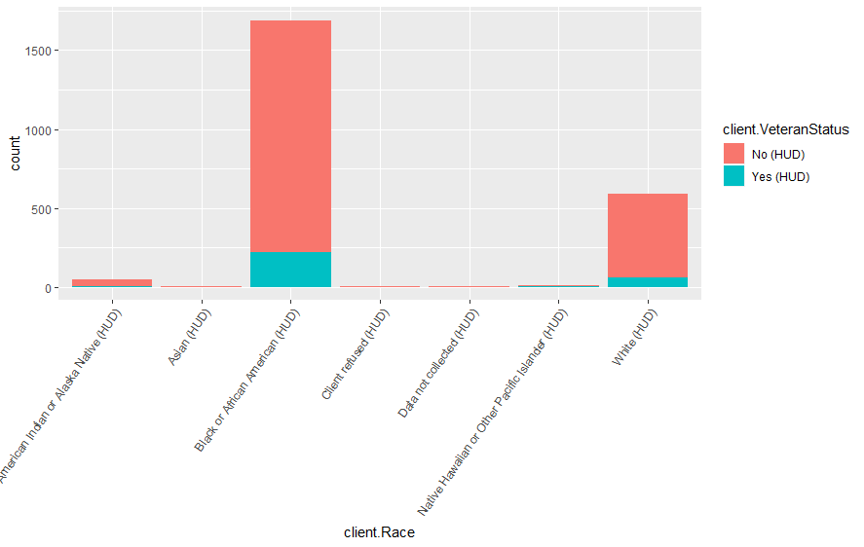
Veteran vs Non-Veteran Population at UMD: Race
82% of the veterans at UMD are Black or African American
23% of the veterans at UMD are White

Slide 7
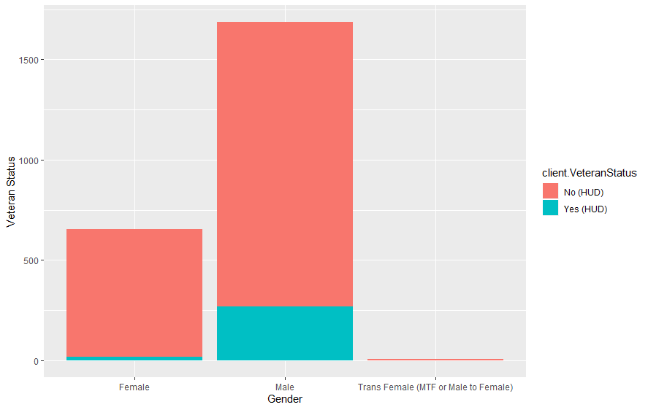
Veteran vs Non-Veteran Population at UMD: Gender
16% of the male clients at UMD are veterans
3% of the female clients at UMD are veterans
1 of 8 Trans Female (MTF or Male to Female) UMD clients are veterans

Slide 8
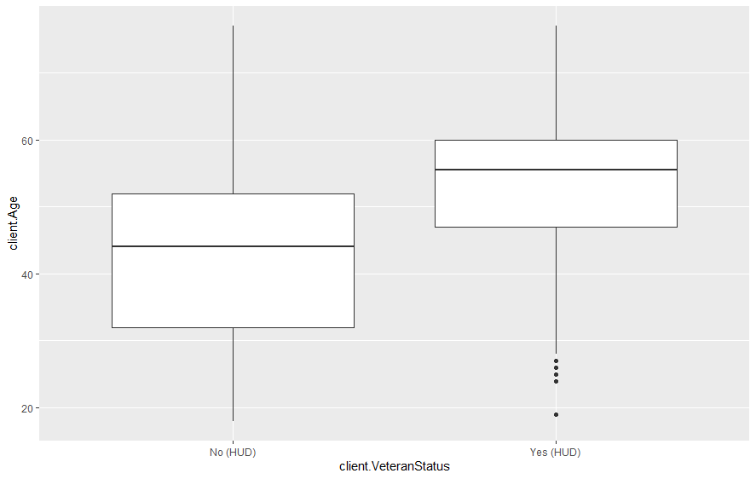
Veteran vs Non-Veteran Population at UMD: Age
The average age of a veteran client is 53 years old
The average age for a non-veteran client is 43 years old

Slide 9
How does the number of reported disabilities by a homeless veteran compare to that of a non-veteran at UMD?

Slide 10
Veteran vs Non-Veteran Population at UMD: Disability Type
63% of the veterans at UMD have reported one or more disability
53% of non-veterans at UMD have reported one or more disability
 | Veteran | Non-Veteran
Alcohol Abuse | 2% | 1%
Both Alcohol and Drug Abuse | 4% | 5%
Chronic Health Condition | 13% | 10%
Developmental | 1% | 3%
Drug Abuse | 1% | 3%
HIV/AIDS | 2% | 2%
Mental Health Problem | 27% | 30%
Physical/Medical | 43% | 26%

Slide 11
Summary
The demographic profile of the homeless veteran population at UMD is generally consistent with that of homeless non-veteran population in regards to gender and race
There is a significant difference is median and average ages amongst homeless veterans compared to the non-homeless veteran population at UMD
Veterans report disabilities at a higher rate than non-veterans
Majority of the disability types were reported consistently across both groups with the exception of Physical/Medical health.

Slide 12
Thank You.

